Slide 1
Supporting your child’s writing in Reception

Slide 2
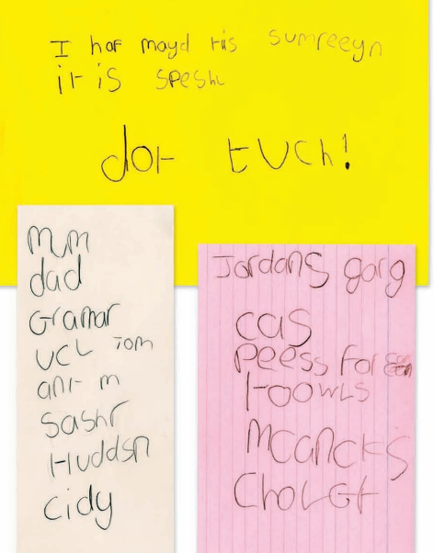
Expected level of writing to meet the ELG

Slide 3
Writing in EYFS
Write recognisable letters, most of which are correctly formed.
Spell words by identifying sounds in them and representing the sounds with a letter or letters.
Write simple phrases and sentences that can be read by others.
Hold a pencil effectively in preparation for fluent writing – using the tripod grip in almost all cases.

Slide 4
Hold a pencil effectively in preparation for fluent writing – using the tripod grip in almost all cases.

Slide 5
Write recognisable letters, most of which are correctly formed.
All children were given a letter formation sheet earlier in the year and access to the RWI handwriting rhymes. There are sheets available to collect as you leave.
We encourage children to write on the line and starting over to the left. If you did not get a lined writing book last term please dojo me and I can get you one.

Slide 6
Spell words by identifying sounds in them and representing the sounds with a letter or letters.
https://schools.ruthmiskin.com/training/view/nzON0ZXj/XQcxNuP8
We encourage children to use ‘Fred fingers’ to identify how many sounds and then attempt to write them. They have access to sound mats that they can use if needed. All children were given a sound mat earlier in the year, again there are some if you would like to collect one on the way out.

Slide 7
Write simple phrases and sentences that can be read by others.
This involves the children using multiple skills at the same time which can be challenging.
They are encouraged to think of a sentence, say the sentence, write the sentence.
Phonetically plausible spellings.

Slide 8
Example video

Slide 9
Almost inline with expected
Practise letter formation and grapheme/ phoneme correspondence. ( how to write the sounds in the words)
Pencil control- dot to dots, colouring
Verbal sentence structure and writing a couple of words.
Fred fingers and Fred talk practise

Slide 10
Working towards expected
Fine motor practise- tweezers, threading.
Practise writing these shapes.
Lots of verbal sentence practise.
Focus on recognising sounds.

Slide 11
If you feel that you still require help with supporting your child’s writing then please dojo me and I, or your child’s class teacher can help on a 1:1 basis.
We will begin to send writing homework again that will be sent out on a Friday and taken out of reading packs on a Thursday.

